Slide 1

HDFS Log Analysis Using ELK Stack
Presented by-
Aarya Parikh (40262787)
Avaneesh Kanshi (40273760)
Apurba Das (40263612)
Pankaj Sharma (40269802)
Smridhi Verma (40266036)

Slide 2
OUTLINE
Problem Statement
Introduction
Dataset Overview
System Architecture
Results
Conclusion
References

Slide 3
PROBLEM STATEMENT
HDFS Log Volume: HDFS logs are generated from various operations, including file system usage and diagnostic processes. These logs create a large volume of data, making manual analysis nearly impossible due to the overwhelming "noise."
Challenges: Analyzing these logs is critical for diagnosing issues, improving system performance, and maintaining high availability in distributed architectures. However, this process is time-consuming and complex.
Existing Gaps: Current approaches face significant limitations, such as the inability to process logs in real time, lack of scalability, and insufficient actionable insights. As a result, the sensory systems used in distributed setups often fall short of meeting operational demands.
Need: There is a clear requirement for a user-friendly, automated system that can handle large volumes of HDFS logs. Such a system should be capable of scaling efficiently, providing visual insights, and enabling easy search functionality. This would enhance performance, simplify diagnostics, and help reduce faults in the system.

Slide 4
INTRODUCTION
The Hadoop Distributed File System (HDFS) plays a vital role in managing files across distributed systems with high storage capacities. It generates a variety of logs—capturing events such as file creation, block replication, and system diagnostics. These logs are essential for identifying and fixing issues, optimizing resource allocation, and maximizing system uptime.
However, the sheer volume of HDFS logs presents significant challenges. Logs are distributed across various nodes and processes, making manual analysis nearly impossible. Troubleshooting and tuning become cumbersome without a streamlined system. To address this, I am leveraging the ELK stack—Elasticsearch, Logstash, and Kibana—an open-source solution for processing and visualizing logs effectively.
Project Goals and Approach The primary goal of this project is to build a scalable log analysis system that offers real-time insights, fault tolerance, and robust performance. To achieve this:
Redis serves as an asynchronous processing layer, enabling efficient data handling.
NGINX is utilized for resource query allocation, ensuring smooth operations even with large datasets.
This approach automates log analysis, simplifying resource management in a distributed environment. By visualizing logs and offering actionable insights in real time, the system enhances overall performance and minimizes operational complexity.

Slide 5
Dataset OVERVIEW
This project uses the HDFS_v3_TraceBench dataset from Loghub and TraceBench, which provides logs collected from a real IaaS environment. The dataset includes over 370,000 traces from 364 files, representing 180+ hours of data collection under various scenarios, including normal operations, different cluster scales, and fault-injected conditions.
The dataset focuses on four primary log types: trace logs, operation logs, edge logs, and event logs, all in CSV format. These logs document key HDFS activities like file creation, data replication, and system performance metrics, enabling detailed analysis through the ELK stack. This structured dataset highlights the effectiveness of ELK in managing and analyzing large-scale distributed system logs.

Slide 6
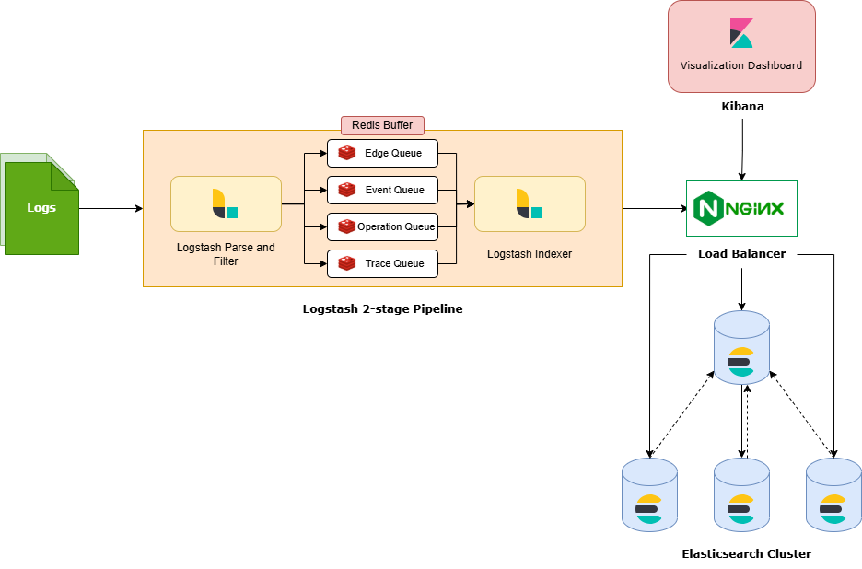
SYSTEM ARCHITECTURE

Slide 7
RESULTS

Slide 8
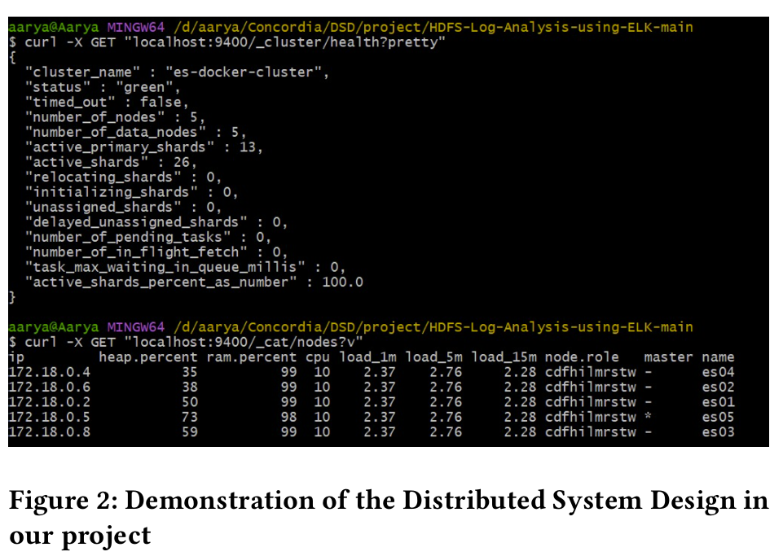
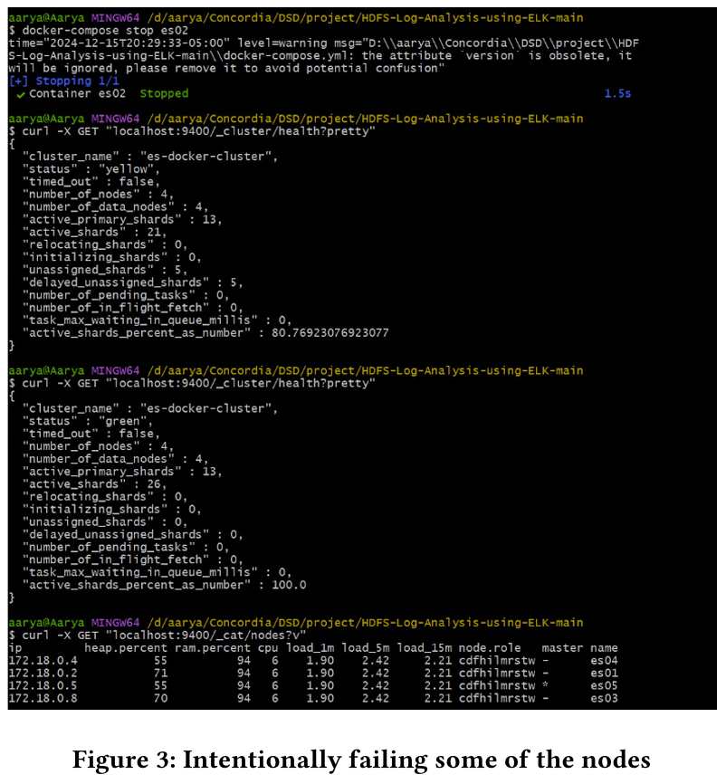
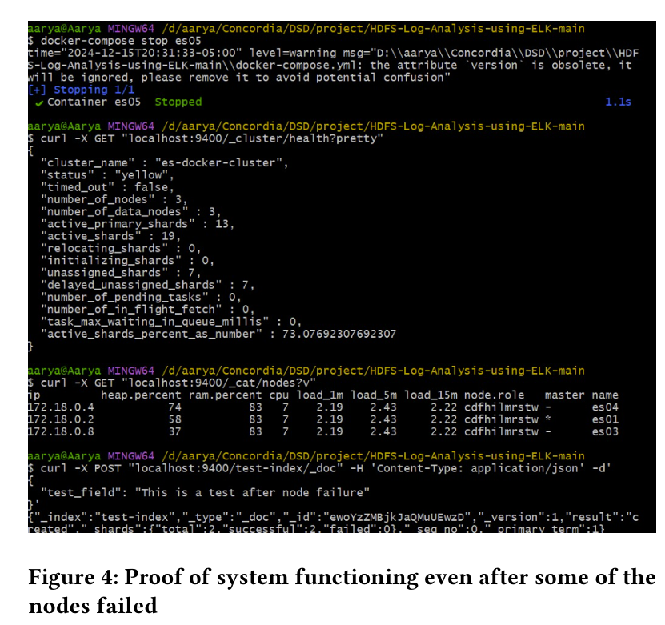
Demo of distributed system design – screenshots

Slide 9
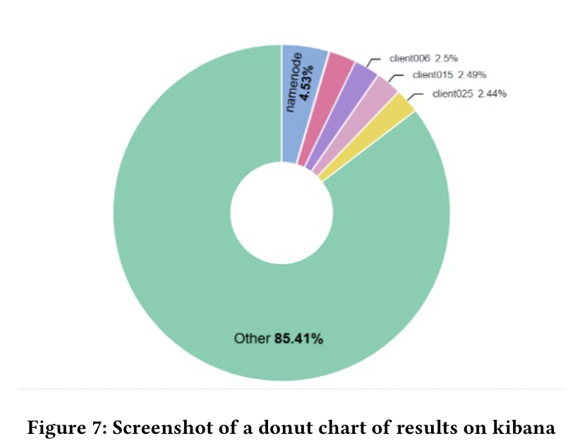
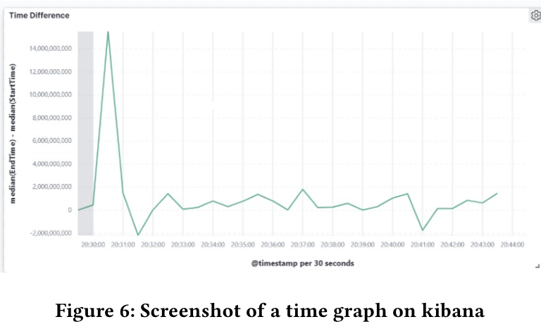
Kibana Dashboard results

Slide 10
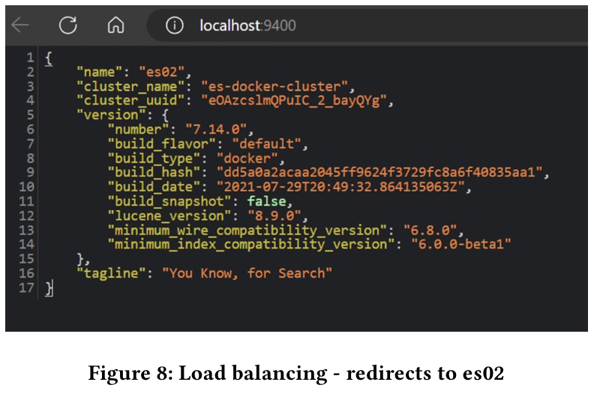
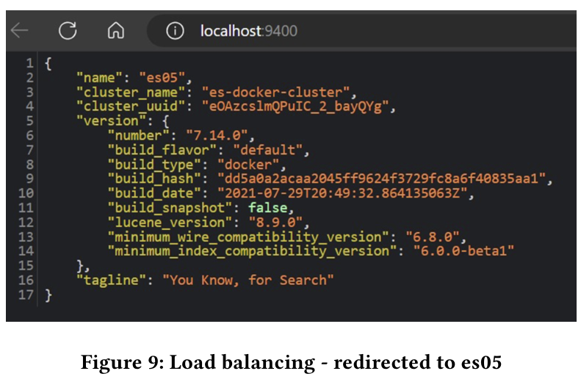
Load balancing screenshots

Slide 11
CONCLUSION
The project to automate HDFS log analysis using the ELK stack has been a success. The system now provides real-time performance monitoring by leveraging Logstash for data input, Redis for buffering, Elasticsearch for storage, and Kibana for visualization. Key achievements include:
Time and Effort Savings: Automation of log retrieval, analysis, and reporting.
High Availability: Distributed configuration ensures redundancy and fault tolerance.
Actionable Insights: Detecting bottlenecks, prioritizing fixes, and optimizing resource usage.
This work demonstrates the ELK stack's effectiveness for managing large-scale log data, ensuring reliable operability and enhanced system performance.

Slide 12
REFERENCES
[1] Loghub Dataset. 2023. Loghub: A Large Collection of System Log Datasets for AI-driven Log Analytics. https://github.com/logpai/loghub.
[2] Mtracer. 2014. TraceBench: An Open Data Set for Trace-oriented Monitoring. https://mtracer.github.io/TraceBench.
[3] Jingwen Zhou, Zhenbang Chen, Ji Wang, Zibin Zheng, and Michael R. Lyu. 2014. TraceBench: An Open Data Set for Trace-oriented Monitoring. In Proceedings of the 6th IEEE International Conference on Cloud Computing Technology and Science (CloudCom).
[4] Jieming Zhu, Shilin He, Pinjia He, Jinyang Liu, and Michael R. Lyu. 2023. Loghub: A Large Collection of System Log Datasets for AI-driven Log Analytics. In Pro-ceedings of the IEEE International Symposium on Software Reliability Engineering (ISSRE).

Slide 13

Thank You

